Slide 1


Dine Manager - Restaurant Ordering System
Team Members:
Han-Sheng Chen, Wei-Hong Lin, Hsuan-Hung Tai

Slide 2




Problem Description
Problem
Operational Needs
Streamlined management of menu items, order processing, and kitchen workflow to ensure smooth daily operations and customer satisfaction.
Challenges Faced
Manual order handling leads to errors, difficulty prioritizing urgent orders, slow menu searches.
Integrated Solution
Utilize different data structures and efficient sorting algorithmn to maintain smooth operations.

Slide 3




System Analysis
Analysis
Functional Requirements
Supports customer ordering interface, kitchen order processing, menu CRUD operations, and real-time data synchronization across modules.
Non-Functional Requirements
Ensures fast menu item search, sorted menu display, and correct order priority without long loading time
Data Structure Selection
Utilizes Hash Table for instant lookup, Binary Search Tree for sorted views, Priority Queue for order management, and Merge Sort for flexible sorting needs.

Slide 4
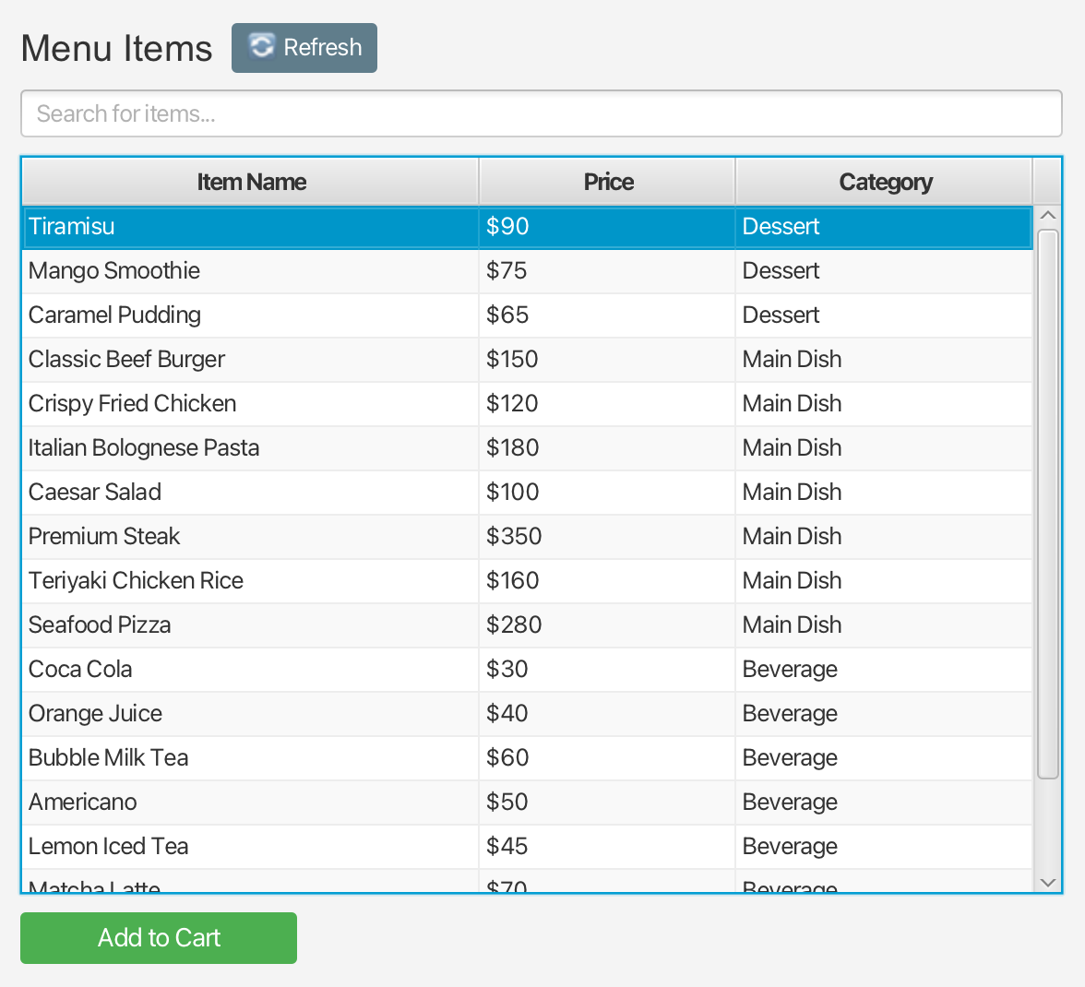
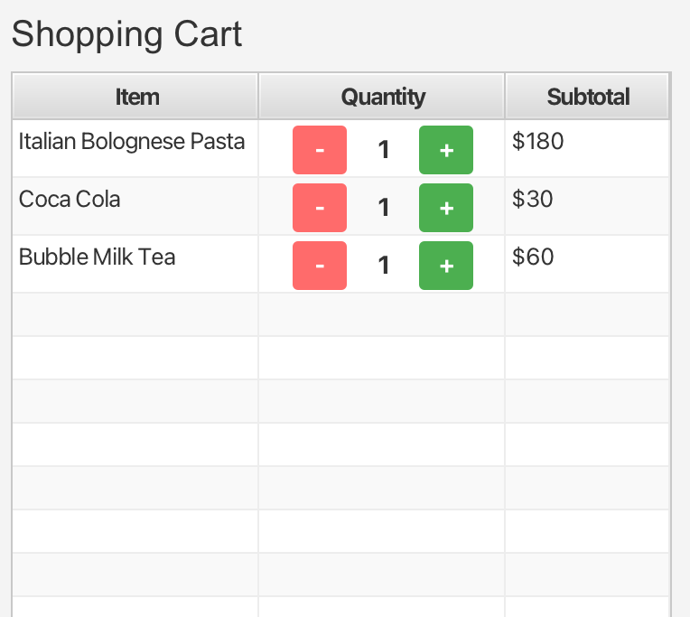
Design: Customer Ordering System
Design
01
02
03
Key Components
Data Flow Overview
Core Features
Includes Menu Display powered by ListView for easy item browsing, Shopping Cart implemented with TableView for clear itemization, and an Order Submission interface to finalize purchases.
Users browse the menu to select items, add or remove them from the cart, then submit the finalized order which enters the processing queue for kitchen preparation.
Supports browsing menu items by category, managing cart contents dynamically, calculating order totals in real time, and submitting orders efficiently to optimize restaurant workflow.
Notes:
so to design customer ordering system,
we use JAVA fx UI component ListView to show all the available menu items,
and use tableview to show added items in shopping cart
therefore, user can browse the menu, add whatever they want into shopping cart and then checkout
so the main function in this system include browsing menu items, adding or removing cart items and checkout

Slide 5
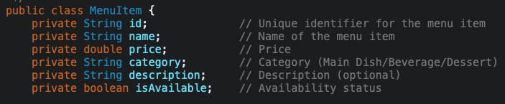
Hash Table
Data Structures
01
02
Hash Table ADT
Order Processing Efficiency
Implemented as a generic HashTable<K,V> with a MenuHashTable wrapper for menu items. Supports O(1) average time complexity for operations: put, get, containsKey, and remove, enabling instant menu item lookups.
HashTable<K,V> key: each menu item's id value: MenuItem object
Combining Hash Table for quick menu data retrieval and Priority Queue for orderly processing ensures smooth, error-free operations and timely handling of all customer orders.
Notes:
and in the implementation of hash table ADT
I define all the methods including put, get, containsKey, and remove in HashTableInterface
with generic type (K and V),
where Key could be each menu item's id, and Value could be MenuItem object
and then using a MenuHashTable wrapper class to operate on the menu items,
and once user checkout the order, the order would be added into Priority Queue for Kitchen Management

Slide 6

Design: Kitchen Management System
Design
Components Overview
The system build with two section, an in-process order TableView and a real-time Detail Panel. The Detail Panel dynamically loads the current focused order, while the TableView displays all orders that are not in the Waiting stage. A label at the top displays the current number of orders waiting to be processed. Interactive buttons dynamically adjust based on the order's stage.
Order Processing Flow
Orders are managed in a priority queue, with higher-priority orders processed first. Staff can handle up to twn orders simultaneously. When an order is completed or canceled, the system automatically switches to another in-progress order if available; otherwise, it loads the next waiting order.
Key Features
A custom Min-Heap priority structure, Automatic order advancement, real-time status tracking, maintains accurate waiting counts, and UI prevents invalid user actions.

Slide 7



Priority Queue
Data Structures
Custom Priority Queue ADT
Priority Levels & Sorting Logic
ArrayList for Processed Order
I built a custom Priority Queue ADT using a custom Min-Heap backed by an array.
It supports fast O(log n) insertion/removal and ensures the kitchen always receives the correct next order based on priority and timestamp. This gives full control over how orders are ranked and processed.
I defined two priority levels: Delivery (1) and Normal (2), where lower values indicate higher urgency.
Orders are sorted using a min-heap implemented as a complete binary tree (CBT). Insertion performs heapify-up and removal performs heapify-down, both with O(log n) worst-case complexity. When priorities are equal, timestamps maintain FIFO ordering to ensure earlier orders are served first.
Once an order is no longer waiting (either completed or canceled), it is removed from the priority queue and appended to a processed-order ArrayList in the order it was handled.
Since the priority queue always remove the highest-priority order, the ArrayList naturally preserves the chronological sequence of all processed orders, providing clear visibility into order history.

Slide 8
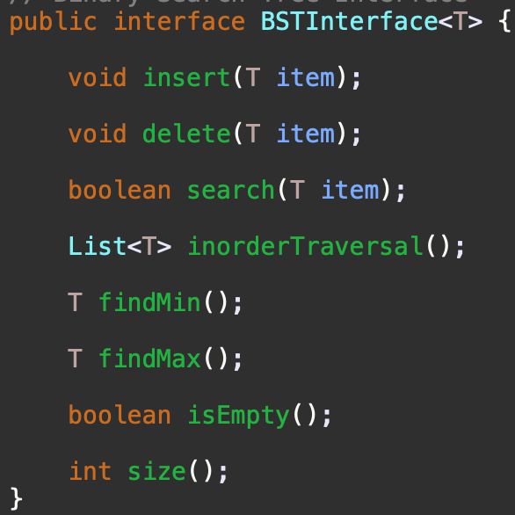
Design: Menu Management System
Design
MVC Architecture
BST Automatic Sorting
Merge Sort with Timing
Model representing MenuItem, Order, OrderItem data classes
View as MenuManagement page UI
Controller handling user inputs and business logics
Implement with multiple comparators (price, name, category)
Display real-time execution timing in milliseconds for performance monitoring.

Slide 9



Binary Search Tree Implementation
Data Structures
Architecture Overview
Sorting Logic
Core Operations
Performance Complexity
BSTInterface<T> for generic operations
BST<T> implementing core logic with Comparator support
MenuBST as a specialized wrapper for MenuItem objects.
Primary sorting by Price ensures cost-based ordering;
Secondary sorting by ID, maintaining consistent and predictable order within the BST.
Basic insert, delete, search,
InorderTraversal for sorted data retrieval;
RangeSearch for filtered results, findMin/findMax for boundary queries;
Run in O(log n) time
Ensure scalability for large menus
Maintain fast access and updates.

Slide 10




Merge Sort Algorithm
Algorithm
Algorithm Characteristics
Divide and conquer. Time complexity of O(n log n) and space complexity of O(n). Preserve original order of equal elements.
Sorting Process
The list is recursively divided into halves, each half is sorted independently, then merged together in sorted order to form the final sorted list.
Multiple Comparators
Supports sorting by Price (ascending/descending), Name (A-Z/Z-A), and Category, allowing flexible menu organization based on user preference.
Performance Measurement
Real-time timing is displayed in milliseconds during sorting to assess efficiency and provide feedback for optimization.

Slide 11

Integration
DataManager Central Hub
System Integration
Manages core data structures including menuHashTable, menuBST, and orderQueue for maintaining data integrity.
MenuService
Provides a single interface for CRUD operations, data validation, and search functionality, coordinating updates between Hash Table and BST to maintain data consistency.
Integration Flow
New menu items are validated, added to the menuHashTable for quick access, inserted into the menuBST to maintain sorted order, and the GUI is updated to reflect changes immediately.

Slide 12


Implementation Details
Implementation
Development Environment & Architecture
Built using Java for robustness
JavaFX for interactive GUI
Eclipse IDE for development
Follows MVC design pattern (Model, View, Controller)
Code Structure & Tools
Model: MenuItem, Order, OrderItem classes
View: JavaFX pages with TableView, ListView, ComboBox
Controller: event handlers for user actions
Service: business logic and coordination
ADTs: HashTableInterface, PriorityQueueInterface, BSTInterface
Implementation: data structure for custom ADTs

Slide 13
Results: System Functionality
Results
The DineManager system is a fully functional restaurant management application with three integrated modules working seamlessly together.
The Customer Ordering interface provides an intuitive experience for browsing menus, managing cart items, and completing orders. The Kitchen Management module enables staff to track orders in real-time, update statuses efficiently, and manage both active and incoming orders with clear visibility. The Menu Management interface allows administrators to maintain and update menu items through a clean, organized dashboard.
Under the hood, custom-built data structures ensure optimal performance: O(1) hash table lookups for menu items, O(log n) priority queue operations for order processing, and sequential ArrayList storage for order history. The GUI maintains consistency across all modules with synchronized real-time updates, providing a smooth and responsive user experience

Slide 14

Results: Performance
Performance
Binary Search Tree (BST)
Merge Sort Timings
Priority Queue Ordering
HashTable
Sorted 18 menu items automatically by price ranging from $30 to $350. Maintains order with efficient O(log n) insertion and retrieval, ensuring quick access to sorted data.
Sorting performance measured in milliseconds: Price sorting takes 0.05ms, Name sorting 0.08ms, and Category sorting 0.06ms. Demonstrates stable and fast sorting across different attributes.
Operations run in O(log n) because a heap is a complete binary tree. Each insert or remove only adjusts the position of one element along the tree height — which is log n, not n
Fast O(1) menu item access through hash-based indexing. Uses separate chaining for collision handling and maintains performance with automatic resizing at 0.75 load factor threshold.

Slide 15
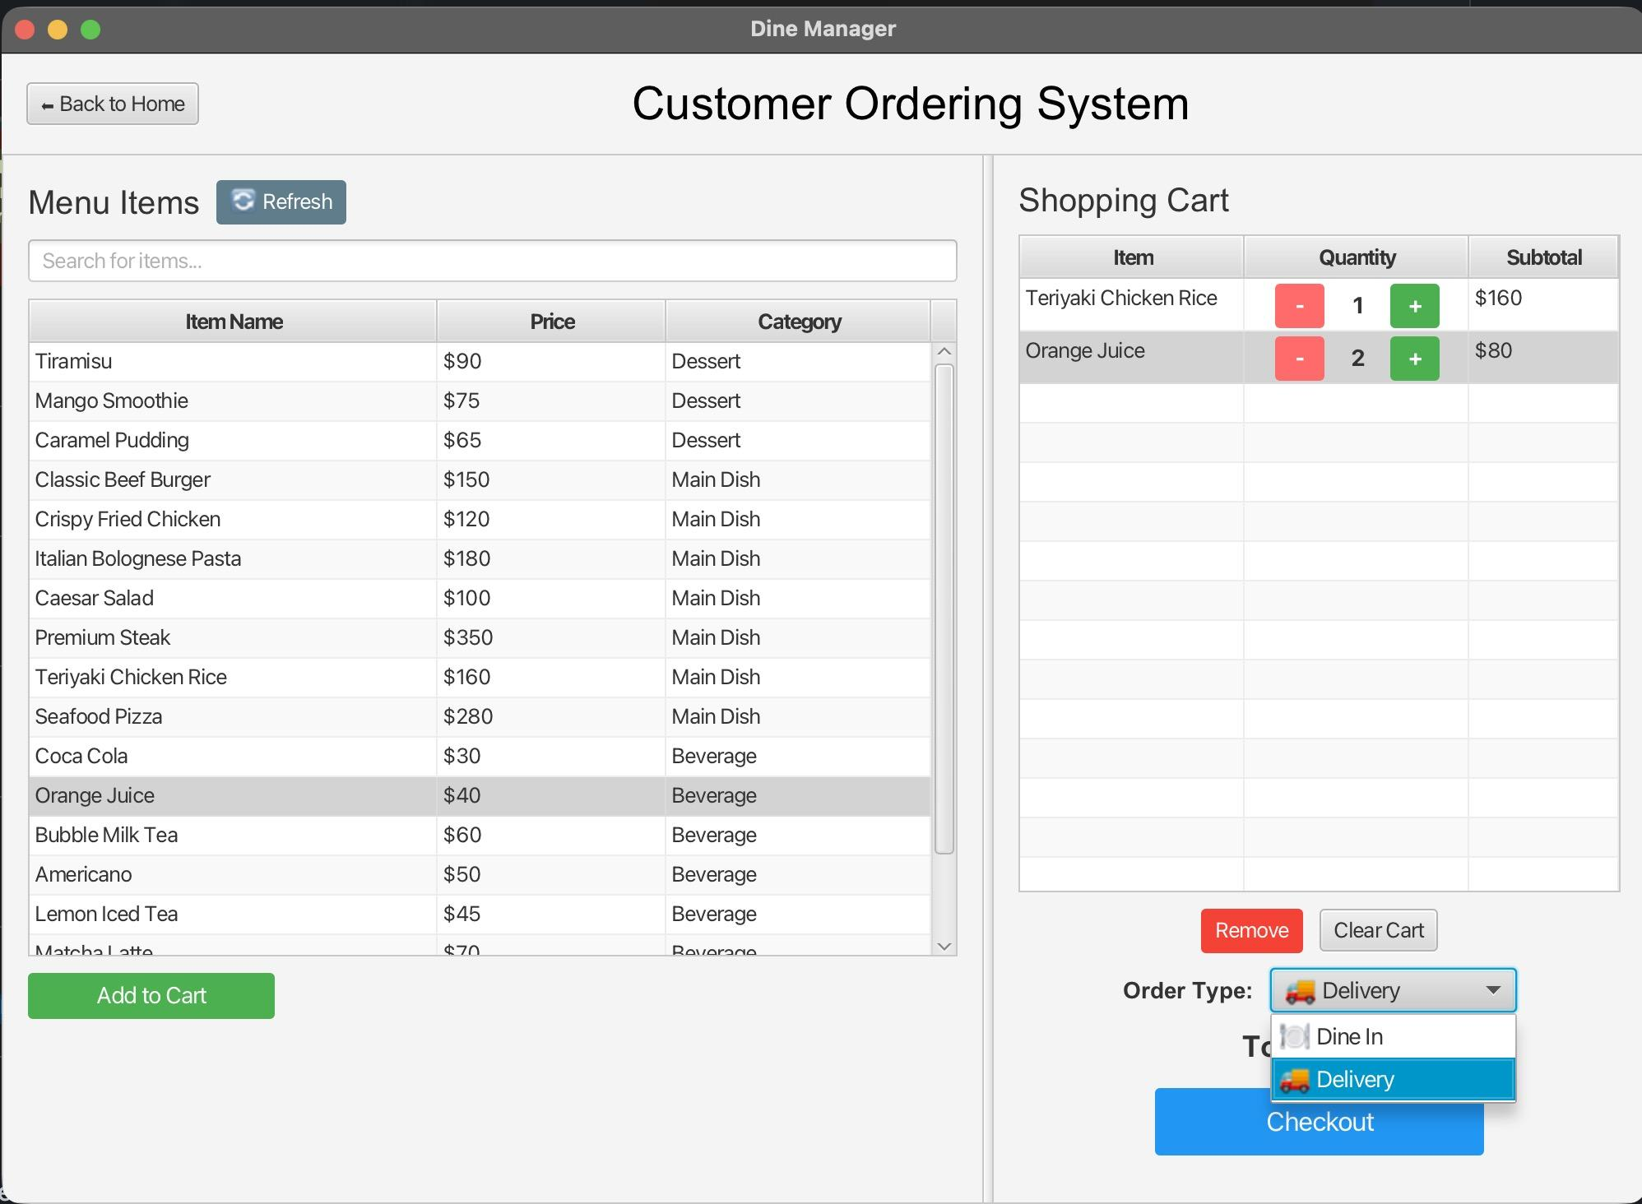
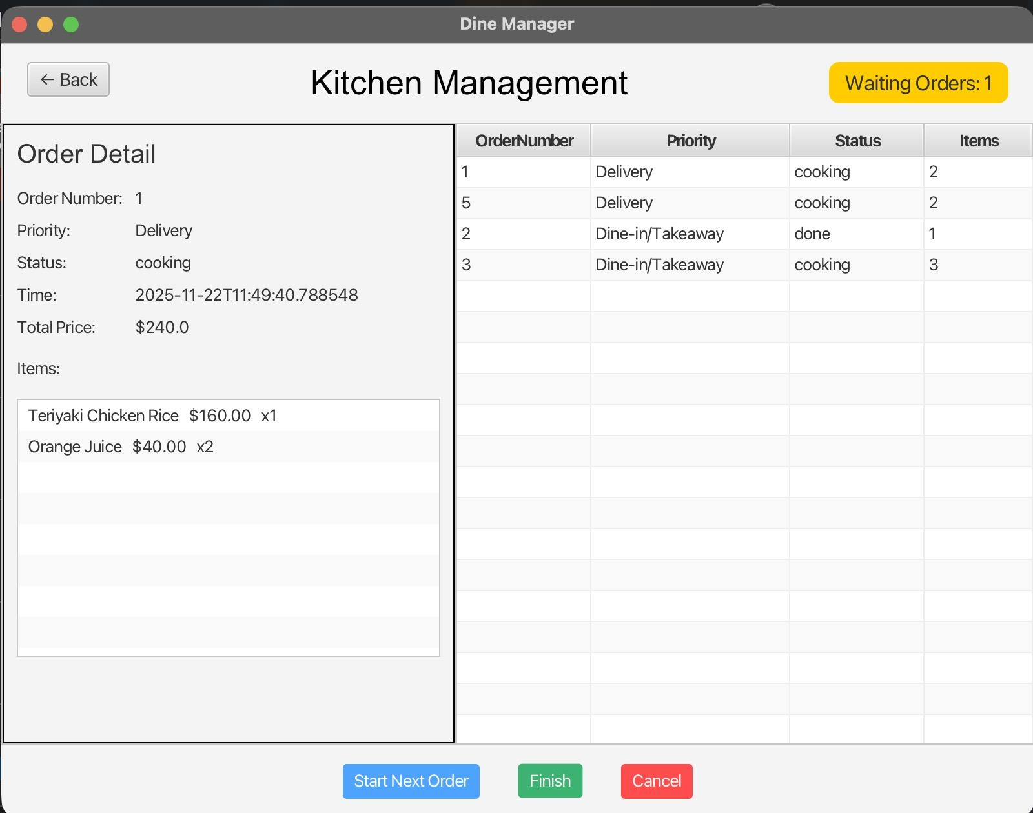
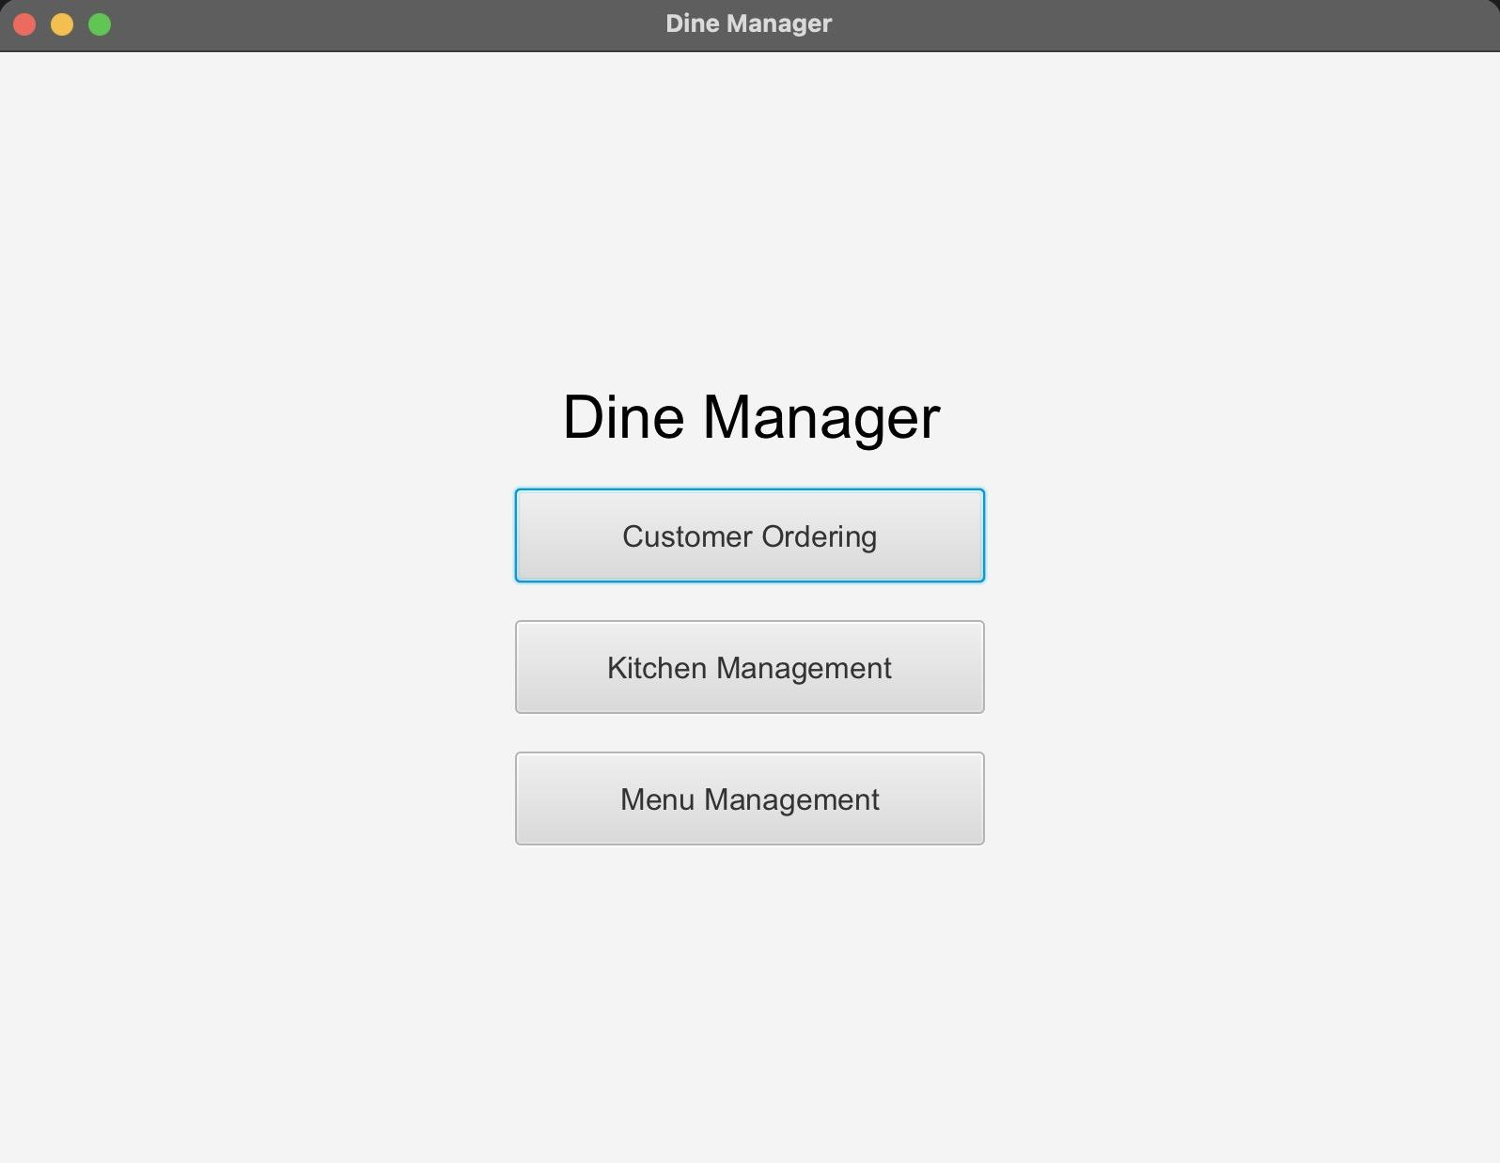
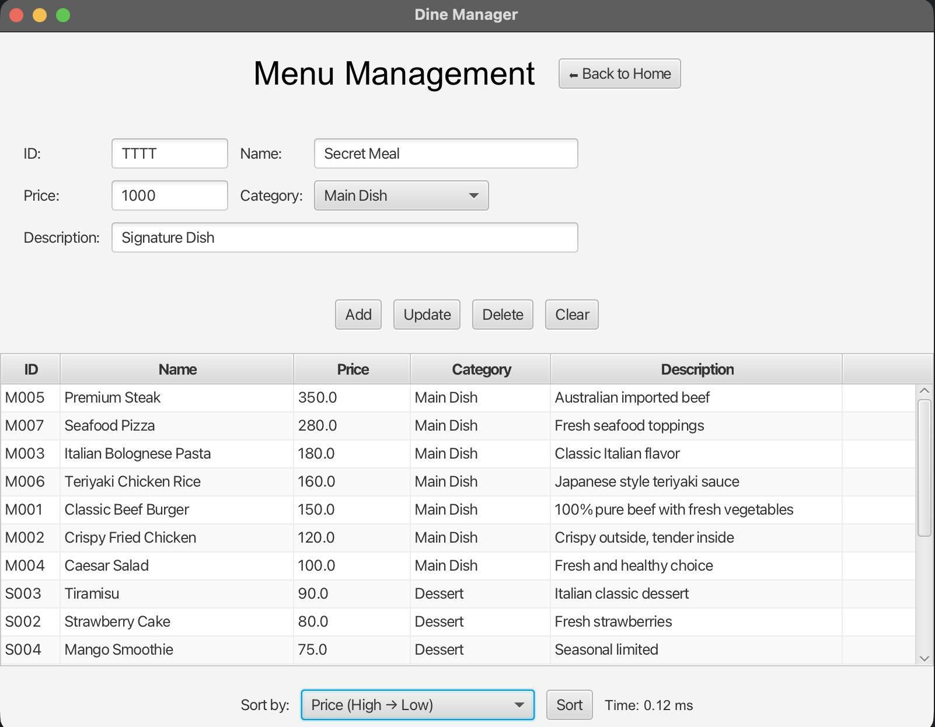
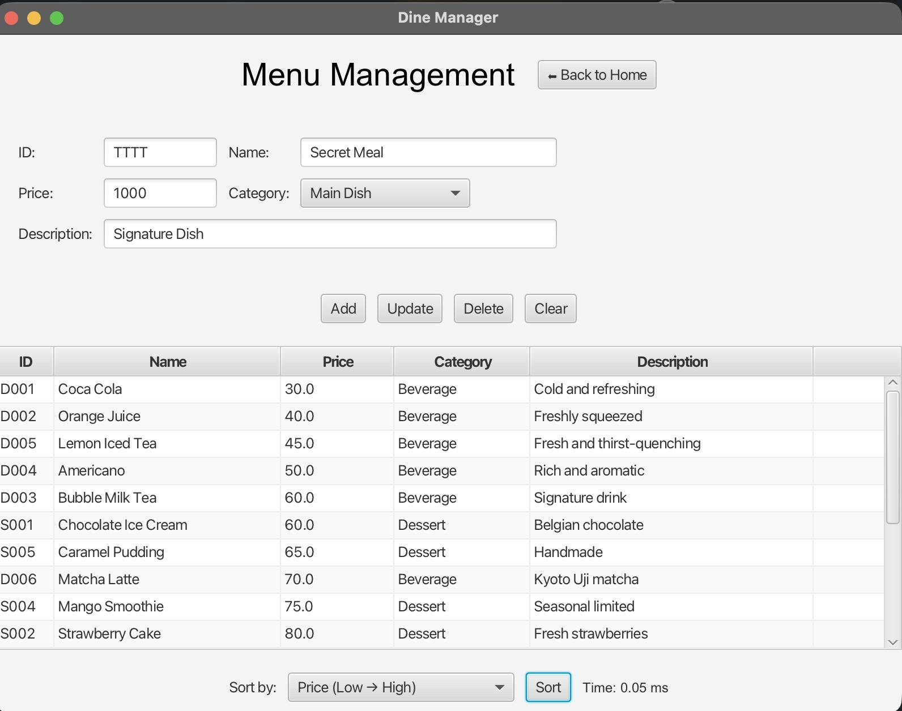
Result: Application

Slide 16
Discussion & Reflection
Reflection
1
2
3
4
Initial Design & Architecture
Integration Challenges
Duplicate Data Handling
Testing & Validation
Focused on modular design principles with low coupling and MVC architecture to ensure scalability and maintainability.
Faced complexities integrating multiple data structures; resolved with a centralized DataManager to synchronize updates and maintain consistency.
Identified and addressed duplicate price entries using composite keys, improving data accuracy and system reliability.
Conducted extensive unit and integration testing, confirming system robustness and seamless user experience across modules.
Notes:
so for the discussion and reflection part,
we implement MVC architecture to ensure each module is low coupling,
and using centralized DataManager to manage and integrate all data across different data structure
also, to avoid conflict between duplicate data, we use composite key to handle duplicate price entries
additionally, we implement unit and integration test to make sure each module is robust enough

Slide 17

Conclusion
Conclusions & Future Work
Key Conclusions and Future Enhancements
The system successfully integrates multiple advanced data structures, including Hash Tables, Priority Queues, and Binary Search Trees, to ensure efficient order and menu management.
User-friendly GUI with JAVA FX and MVC architecture provide seamless interaction and maintainability across the customer ordering and kitchen modules.
Future development plans include implementing database persistence for data durability, user authentication for security, and analytics for business insights.
Additional features planned are real-time notifications, a dedicated mobile app for accessibility, and comprehensive reporting tools to support restaurant management decisions.
Notes:
and to sum up, we successfully integrate three main data structures including Hash Tables, Priority Queues, and Binary Search Trees with MVC architecture, to well manage our menu and order
and also we use java fx to design user friendly GUI
in the future, we can add more features, like implementing database, user authentication, and even user data analysis for business insights
and that’s all for our today’s presentation, thanks for your listening

Slide 18


Job Assignments
Teamwork
Wei-Hong Responsibilities
Hsuan-Hung Responsibilities
Han-Sheng Responsibilities
Collaboration Approach
Focused on implementing the Hash Table ADT, customer ordering GUI, shopping cart features, and queue integration
Developed the Priority Queue ADT, kitchen management GUI, status management, and priority processing logic
Handled the Binary Search Tree ADT implementation, merge sort algorithm, menu management GUI and controller, data management services, and design templates for code implementation and slides
Weekly meetings, shared interfaces, code reviews, and consistent documentation ensured smooth integration and high code quality across modules.
Notes:
for job assignments,
wei-hong is responsible for implementing hash table adt in customer ordering page,
and hsuan-hung is responsible for implementing priority queue adt in kitchen management page,
and han-sheng is implementing BST adt, merge sort algorithm in menu management page and also data management services
and that’s all for our today’s presentation, thanks for your listening

